Slide 1
Digital Image Processing: Digital Imaging Fundamentals

Slide 2
Contents
This lecture will cover:
The human visual system
Light and the electromagnetic spectrum
Image representation
Image sensing and acquisition
Sampling, quantisation and resolution

Slide 3
Human Visual System
The best vision model we have!
Knowledge of how images form in the eye can help us with processing digital images
We will take just a whirlwind tour of the human visual system

Slide 4
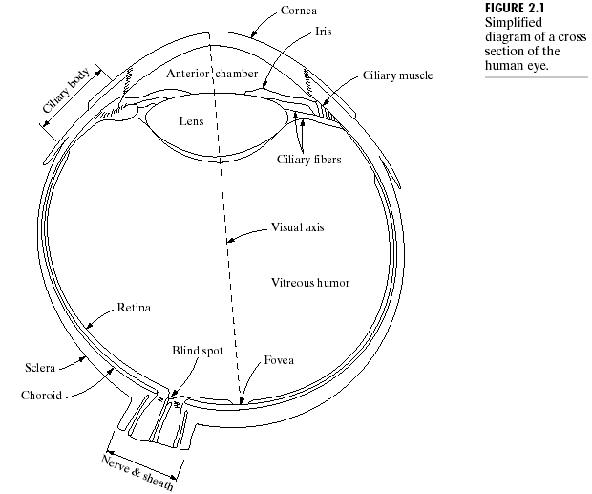

Structure Of The Human Eye
The lens focuses light from objects onto the retina
The retina is covered with light receptors called cones (6-7 million) and rods (75-150 million)
Cones are concentrated around the fovea and are very sensitive to colour
Rods are more spread out and are sensitive to low
levels of illumination
Images taken from Gonzalez & Woods, Digital Image Processing (2002)
Notes:
Cornea and sclera keep everything in!
The choroid contains all of the blood vessels that serve as nutrition to the eye
The iris contains the pigment that gives our eyes their colour
Rods for general vison cones for details
Blind spot is where the optic nerve connects
BLIND SPOT EXPERIMENT
Women have extra cones which means they can see more colours

Slide 5

Blind-Spot Experiment
Draw an image similar to that below on a piece of paper (the dot and cross are about 6 inches apart)
Close your right eye and focus on the cross with your left eye
Hold the image about 20 inches away from your face and move it slowly towards you
The dot should disappear!

Slide 6


Slide 7
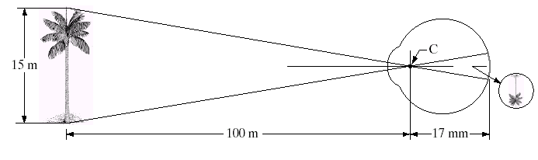
Image Formation In The Eye
Muscles within the eye can be used to change the shape of the lens allowing us focus on objects that are near or far away
An image is focused onto the retina causing rods and cones to become excited which ultimately send signals to the brain

Slide 8
Brightness Adaptation & Discrimination
The human visual system can perceive approximately 10¹⁰ different light intensity levels
However, at any one time we can only discriminate between a much smaller number – brightness adaptation
Similarly, the perceived intensity of a region is related to the light intensities of the regions surrounding it

Slide 9
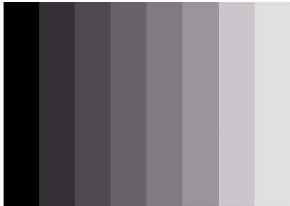

Brightness Adaptation & Discrimination (cont…)
Images taken from Gonzalez & Woods, Digital Image Processing (2002)
An example of Mach bands
Notes:
Mach bands were named after Ernst Mach who described the phenomenon in 1865

Slide 10
Brightness Adaptation & Discrimination (cont…)
Images taken from Gonzalez & Woods, Digital Image Processing (2002)
Notes:
Mach bands were named after Ernst Mach who described the phenomenon in 1865

Slide 11
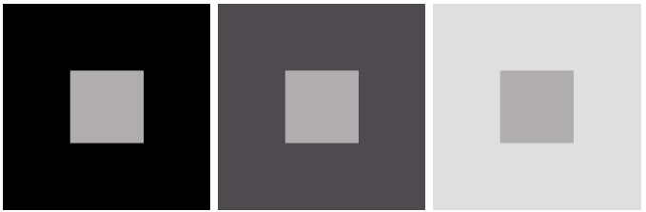
Brightness Adaptation & Discrimination (cont…)
Images taken from Gonzalez & Woods, Digital Image Processing (2002)
An example of simultaneous contrast
Notes:
Mach bands were named after Ernst Mach who described the phenomenon in 1865

Slide 12
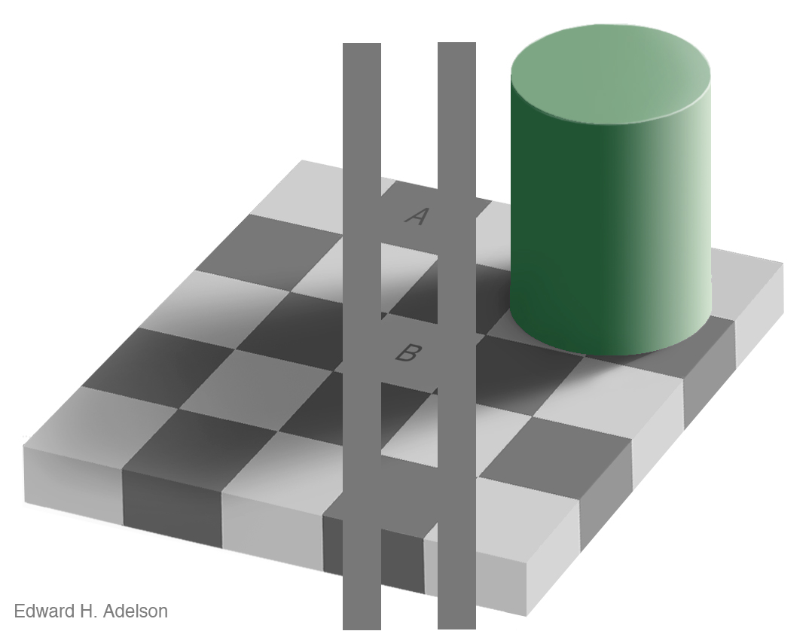
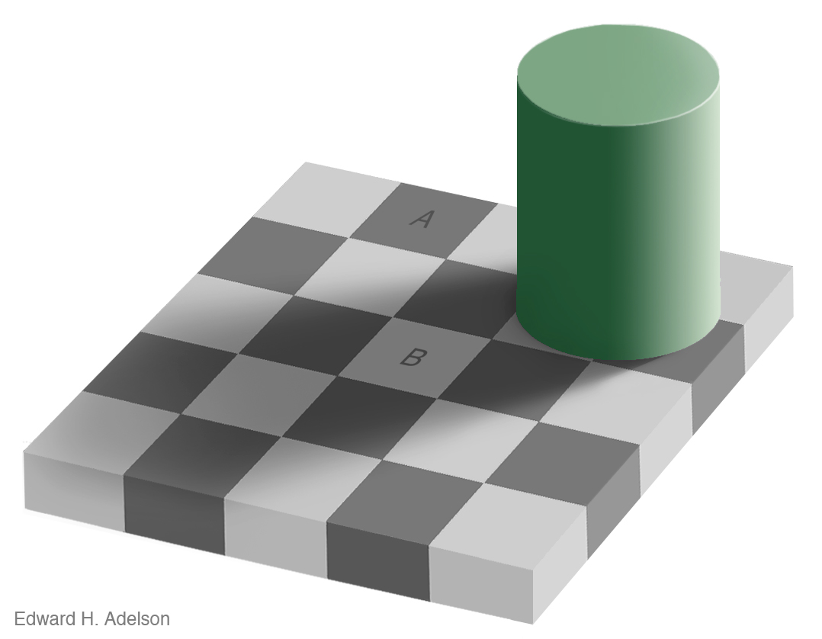
Brightness Adaptation & Discrimination (cont…)
For more great illusion examples take a look at: http://web.mit.edu/persci/gaz/
Notes:
Mach bands were named after Ernst Mach who described the phenomenon in 1865

Slide 13
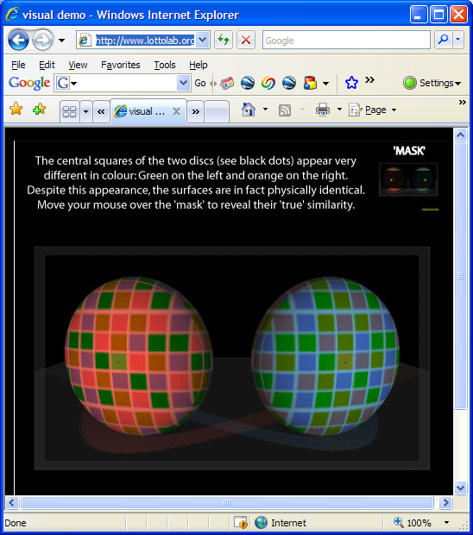
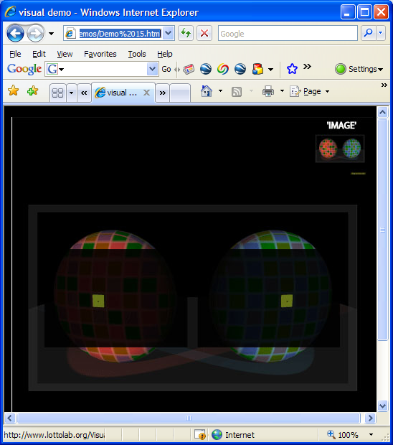
Available here: http://www.lottolab.org/Visual%20Demos/Demo%2015.html

Slide 14
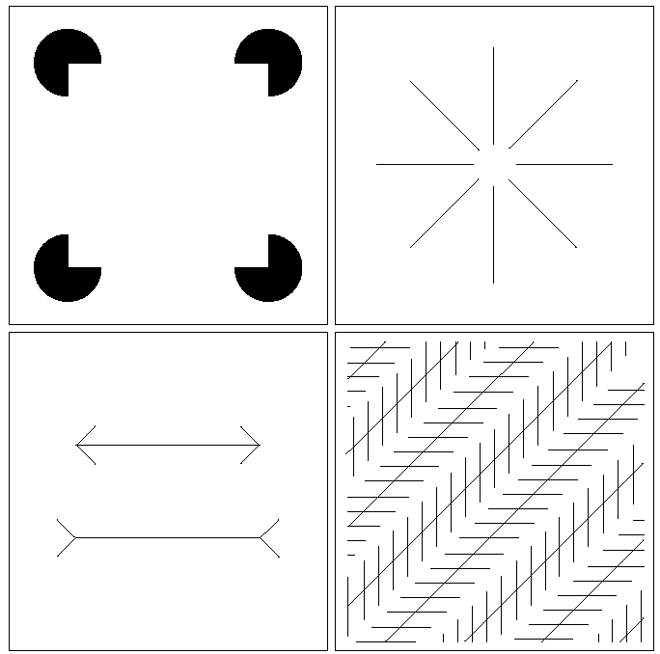
Optical Illusions
Our visual systems play lots of interesting tricks on us

Slide 15
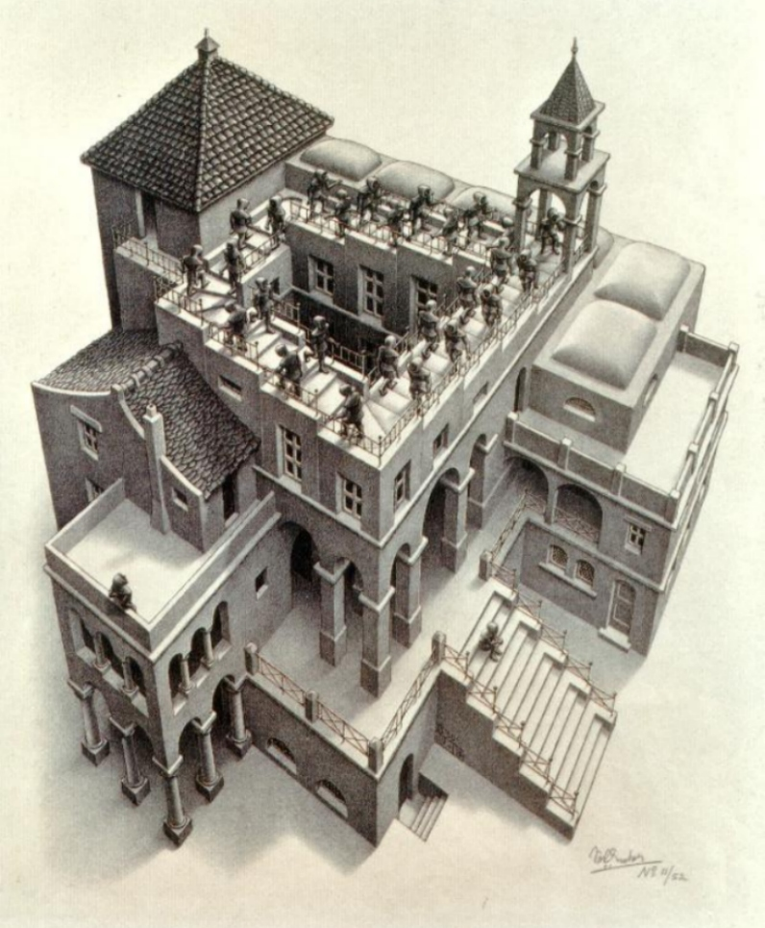
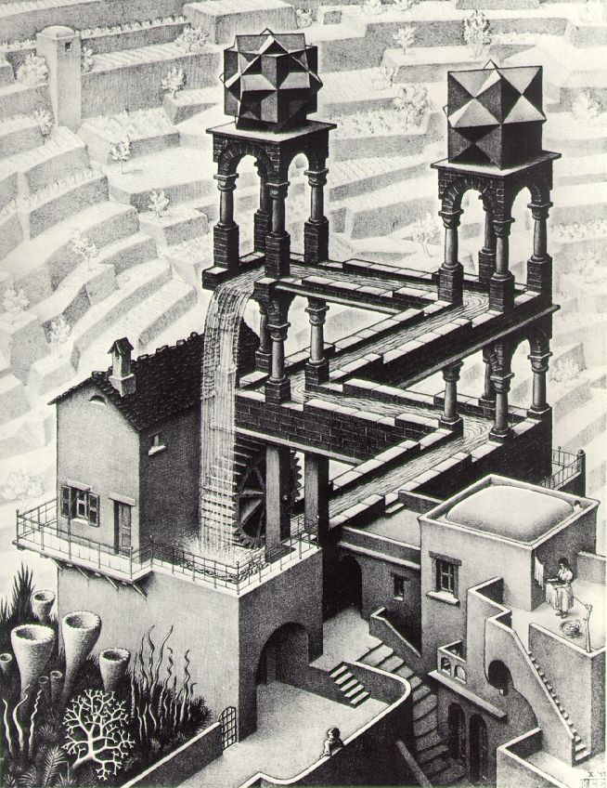
Optical Illusions (cont…)

Slide 16
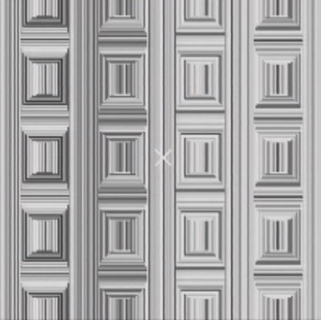
Optical Illusions (cont…)
Stare at the cross in the middle of the image and think circles

Slide 17
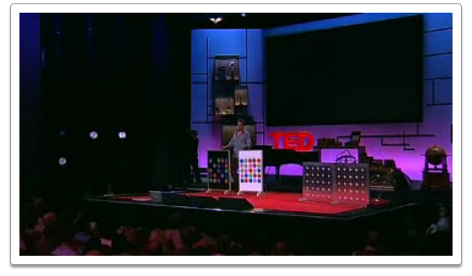

Mind Map Exercise: Mind Mapping For Note Taking
Beau Lotto: Optical Illusions Show How We See
http://www.ted.com/talks/lang/eng/beau_lotto_optical_illusions_show_how_we_see.html

Slide 18
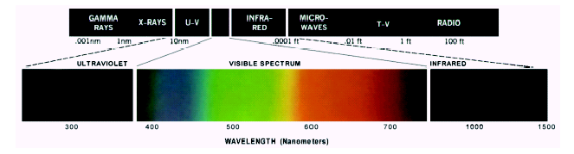
Light And The Electromagnetic Spectrum
Light is just a particular part of the electromagnetic spectrum that can be sensed by the human eye
The electromagnetic spectrum is split up according to the wavelengths of different forms of energy
Notes:
In 1666 Sir Isaac Newton discovered that light passed through a prism splits into a continuous spectrum of colours
Many image applications use electromagnetic radiation that is far outside the visual spectrum – x-ray images, infra-red images – we genrate images of these images by mapping them to the visual spectrum

Slide 19
Reflected Light
The colours that we perceive are determined by the nature of the light reflected from an object
For example, if white light is shone onto a green object most wavelengths are absorbed, while green light is reflected from the object
White Light
Colours Absorbed
Green Light

Slide 20
Sampling, Quantisation And Resolution
In the following slides we will consider what is involved in capturing a digital image of a real-world scene
Image sensing and representation
Sampling and quantisation
Resolution

Slide 21
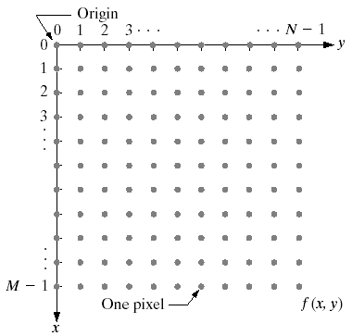
Image Representation
Before we discuss image acquisition recall that a digital image is composed of M rows and N columns of pixels each storing a value
Pixel values are most often grey levels in the range 0-255(black-white)
We will see later on that images can easily be represented as matrices
col
Images taken from Gonzalez & Woods, Digital Image Processing (2002)
f (row, col)
row

Slide 22

Image Acquisition
Images are typically generated by illuminating a scene and absorbing the energy reflected by the objects in that scene
Typical notions of illumination and scene can be way off:
X-rays of a skeleton
Ultrasound of an unborn baby
Electro-microscopic images of molecules
Images taken from Gonzalez & Woods, Digital Image Processing (2002)

Slide 23
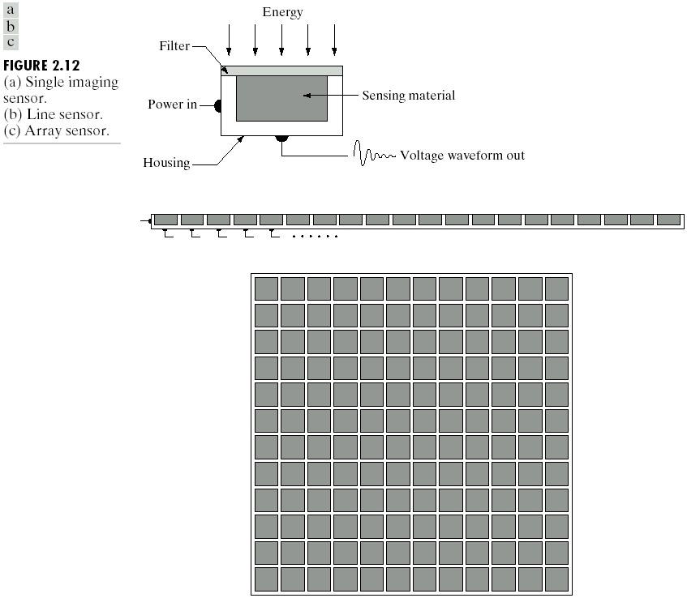
Image Sensing
Incoming energy lands on a sensor material responsive to that type of energy and this generates a voltage
Collections of sensors are arranged to capture images
Images taken from Gonzalez & Woods, Digital Image Processing (2002)
Imaging Sensor
Line of Image Sensors
Array of Image Sensors

Slide 24
Image Sensing
Images taken from Gonzalez & Woods, Digital Image Processing (2002)
Using Sensor Strips and Rings

Slide 25
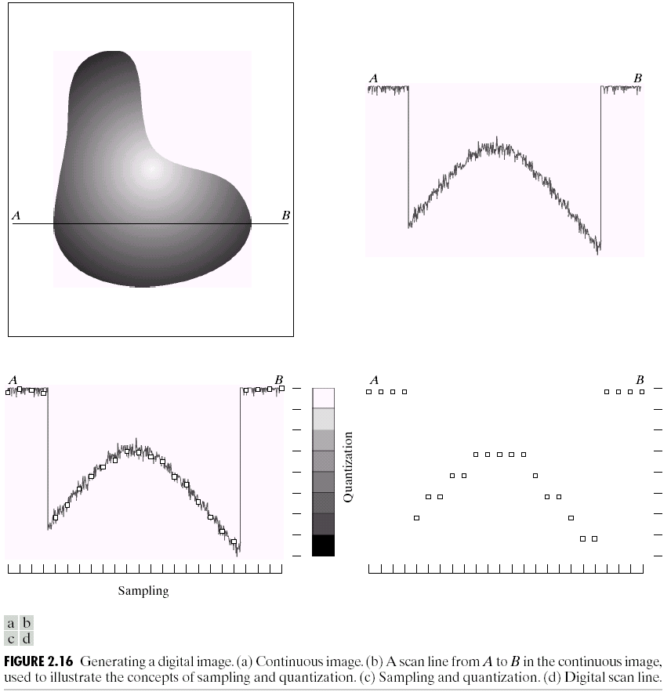
Image Sampling And Quantisation
A digital sensor can only measure a limited number of samples at a discrete set of energy levels
Quantisation is the process of converting a continuous analogue signal into a digital representation of this signal
Images taken from Gonzalez & Woods, Digital Image Processing (2002)
Notes:
Analogue Vs digital
Think of the volume knob on your stereo
Records Vs CDs Vs Mp3s
Nyquist theory etc talks about how much sampling we need to do

Slide 26
Image Sampling And Quantisation
Images taken from Gonzalez & Woods, Digital Image Processing (2002)
Notes:
Analogue Vs digital
Think of the volume knob on your stereo
Records Vs CDs Vs Mp3s
Nyquist theory etc talks about how much sampling we need to do

Slide 27
Image Sampling And Quantisation
Images taken from Gonzalez & Woods, Digital Image Processing (2002)
Notes:
Analogue Vs digital
Think of the volume knob on your stereo
Records Vs CDs Vs Mp3s
Nyquist theory etc talks about how much sampling we need to do

Slide 28

Image Sampling And Quantisation (cont…)
Remember that a digital image is always only an approximation of a real world scene
Images taken from Gonzalez & Woods, Digital Image Processing (2002)

Slide 29
Image Representation
Images taken from Gonzalez & Woods, Digital Image Processing (2002)

Slide 30
Image Representation
Images taken from Gonzalez & Woods, Digital Image Processing (2002)

Slide 31
Image Representation
Images taken from Gonzalez & Woods, Digital Image Processing (2002)

Slide 32
Image Representation
Images taken from Gonzalez & Woods, Digital Image Processing (2002)

Slide 33
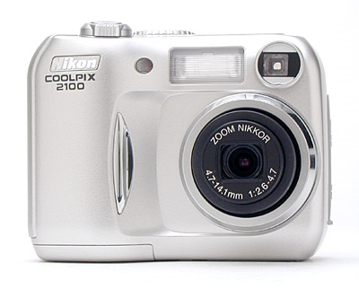
Spatial Resolution
The spatial resolution of an image is determined by how sampling was carried out
Spatial resolution simply refers to the smallest discernable detail in an image
Vision specialists will often talk about pixel size
Graphic designers will talk about dots per inch (DPI)
5.1 Megapixels

Slide 34
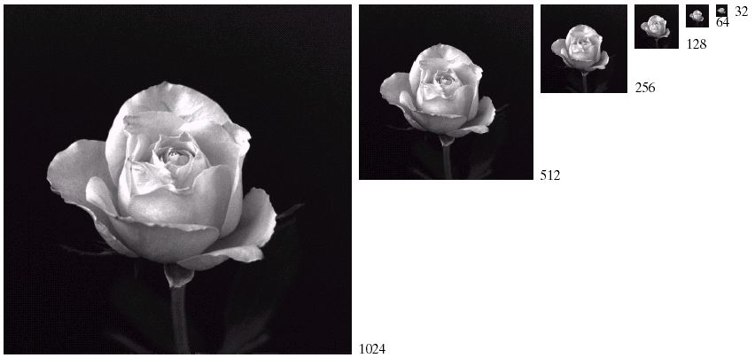
Spatial Resolution (cont…)
Images taken from Gonzalez & Woods, Digital Image Processing (2002)

Slide 35
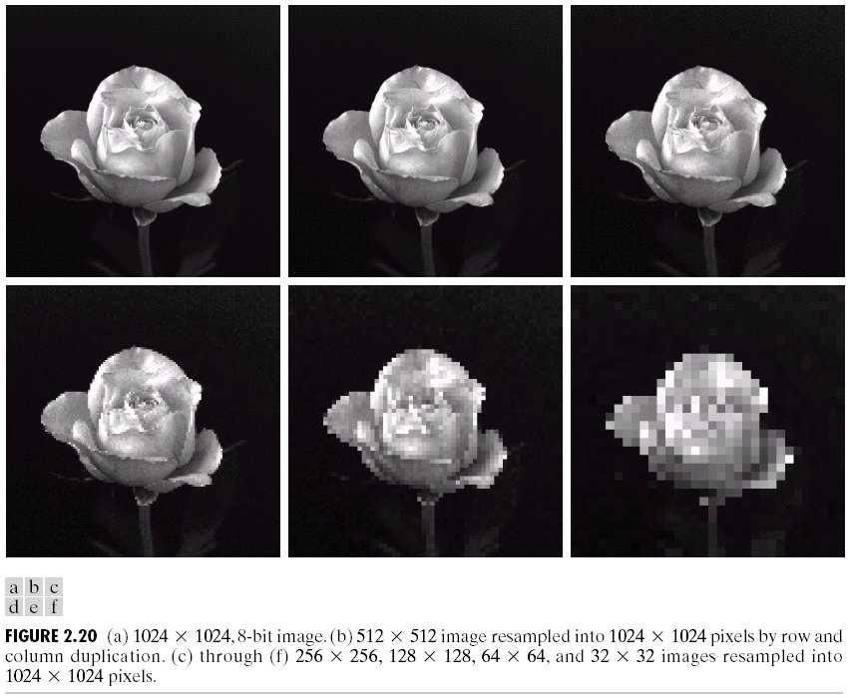
Spatial Resolution (cont…)
Images taken from Gonzalez & Woods, Digital Image Processing (2002)

Slide 36
Spatial Resolution (cont…)
Images taken from Gonzalez & Woods, Digital Image Processing (2002)

Slide 37
Spatial Resolution (cont…)
Images taken from Gonzalez & Woods, Digital Image Processing (2002)

Slide 38
Spatial Resolution (cont…)
Images taken from Gonzalez & Woods, Digital Image Processing (2002)

Slide 39
Spatial Resolution (cont…)
Images taken from Gonzalez & Woods, Digital Image Processing (2002)

Slide 40
Spatial Resolution (cont…)
Images taken from Gonzalez & Woods, Digital Image Processing (2002)

Slide 41
Intensity Level Resolution
Intensity level resolution refers to the number of intensity levels used to represent the image
The more intensity levels used, the finer the level of detail discernable in an image
Intensity level resolution is usually given in terms of the number of bits used to store each intensity level
Number of Bits
Number of Intensity Levels
Examples
1
2
0, 1
2
4
00, 01, 10, 11
4
16
0000, 0101, 1111
8
256
00110011, 01010101
16
65,536
1010101010101010

Slide 42
Saturation & Noise
Images taken from Gonzalez & Woods, Digital Image Processing (2002)

Slide 43
Resolution: How Much Is Enough?
The big question with resolution is always how much is enough?
This all depends on what is in the image and what you would like to do with it
Key questions include
Does the image look aesthetically pleasing?
Can you see what you need to see within the image?

Slide 44
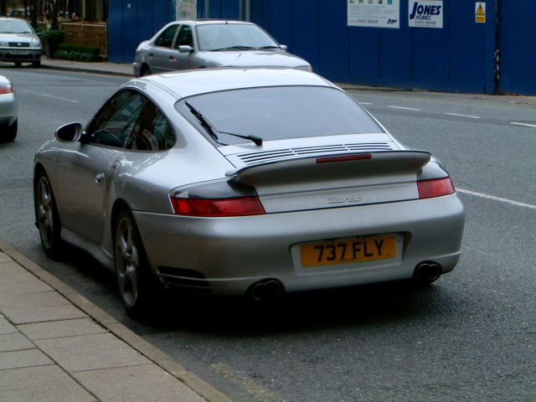

Resolution: How Much Is Enough? (cont…)
The picture on the right is fine for counting the number of cars, but not for reading the number plate

Slide 45
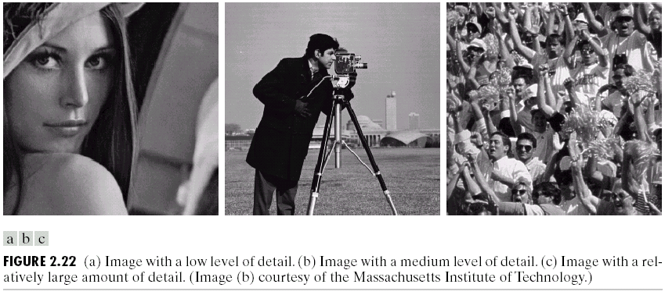
Intensity Level Resolution (cont…)
Images taken from Gonzalez & Woods, Digital Image Processing (2002)
Low Detail
Medium Detail
High Detail

Slide 46
Intensity Level Resolution (cont…)
Images taken from Gonzalez & Woods, Digital Image Processing (2002)

Slide 47
Intensity Level Resolution (cont…)
Images taken from Gonzalez & Woods, Digital Image Processing (2002)

Slide 48
Intensity Level Resolution (cont…)
Images taken from Gonzalez & Woods, Digital Image Processing (2002)

Slide 49
Summary
We have looked at:
Human visual system
Light and the electromagnetic spectrum
Image representation
Image sensing and acquisition
Sampling, quantisation and resolution

Slide 50
Basic Relationships Between Pixels
Neighborhood
Adjacency
Connectivity
Paths
Regions and boundaries

Slide 51
Basic Relationships Between Pixels
Neighbors of a pixel p at coordinates (x,y)
4-neighbors of p, denoted by N₄(p):
(x-1, y), (x+1, y), (x,y-1), and (x, y+1).
4 diagonal neighbors of p, denoted by N_{D}(p):
(x-1, y-1), (x+1, y+1), (x+1,y-1), and (x-1, y+1).
8 neighbors of p, denoted N₈(p)
N₈(p) = N₄(p) U N_{D}(p)

Slide 52
Adjacency
Let V be the set of intensity values
m-adjacency: Two pixels p and q with values from V are m-adjacent if
(i) q is in the set N₄(p), or
(ii) q is in the set N_{D}(p) and the set N₄(p) ∩ N₄(p) has no pixels whose values are from V.

Slide 53
Path
(digital) path (or curve) from pixel p with coordinates (x₀, y₀) to pixel q with coordinates (x_{n}, y_{n}) is a sequence of distinct pixels with coordinates A
(x₀, y₀), (x₁, y₁), …, (x_{n}, y_{n})
Where (x_{i}, y_{i}) and (x_{i-1}, y_{i-1}) are adjacent for 1 ≤ i ≤ n.
Here n is the length of the path.
If (x₀, y₀) = (x_{n}, y_{n}), the path is closed path.
We can define 4-, 8-, and m-paths based on the type of adjacency used.

Slide 54
Examples: Adjacency and Path
V = {1, 2}
0 1 1 0 1 1 0 1 1
0 2 0 0 2 0 0 2 0
0 0 1 0 0 1 0 0 1

Slide 55
Examples: Adjacency and Path
V = {1, 2}
0 1 1 0 1 1 0 1 1
0 2 0 0 2 0 0 2 0
0 0 1 0 0 1 0 0 1
8-adjacent

Slide 56
Examples: Adjacency and Path
V = {1, 2}
0 1 1 0 1 1 0 1 1
0 2 0 0 2 0 0 2 0
0 0 1 0 0 1 0 0 1
8-adjacent
m-adjacent

Slide 57
Examples: Adjacency and Path
V = {1, 2}
01,1 11,2 11,3 0 1 1 0 1 1
02,1 22,2 02,3 0 2 0 0 2 0
03,1 03,2 13,3 0 0 1 0 0 1
8-adjacent
m-adjacent
The 8-path from (1,3) to (3,3):
(1,3), (1,2), (2,2), (3,3)
(1,3), (2,2), (3,3)
The m-path from (1,3) to (3,3):
(1,3), (1,2), (2,2), (3,3)

Slide 58
Basic Relationships Between Pixels
Connected in S
Let S represent a subset of pixels in an image. Two pixels p with coordinates (x₀, y₀) and q with coordinates (x_{n}, y_{n}) are said to be connected in S if there exists a path
(x₀, y₀), (x₁, y₁), …, (x_{n}, y_{n})
Where

Slide 59
Basic Relationships Between Pixels
Let S represent a subset of pixels in an image
For every pixel p in S, the set of pixels in S that are connected to p is called a connected component of S.
If S has only one connected component, then S is called Connected Set.
We call R a region of the image if R is a connected set
Two regions, R_{i} and R_{j} are said to be adjacent if their union forms a connected set.
Regions that are not to be adjacent are said to be disjoint.

Slide 60
Basic Relationships Between Pixels
Boundary (or border)
The boundary of the region R is the set of pixels in the region that have one or more neighbors that are not in R.
If R happens to be an entire image, then its boundary is defined as the set of pixels in the first and last rows and columns of the image.
Foreground and background
An image contains K disjoint regions, R_{k}, k = 1, 2, …, K. Let R_{u} denote the union of all the K regions, and let (R_{u})^{c} denote its complement.
All the points in R_{u} is called foreground;
All the points in (R_{u})^{c} is called background.

Slide 61
Question 1
In the following arrangement of pixels, are the two regions (of 1s) adjacent? (if 8-adjacency is used)
1 1 1
1 0 1
0 1 0
0 0 1
1 1 1
1 1 1
Region 1
Region 2

Slide 62
Question 2
In the following arrangement of pixels, are the two parts (of 1s) adjacent? (if 4-adjacency is used)
1 1 1
1 0 1
0 1 0
0 0 1
1 1 1
1 1 1
Part 1
Part 2

Slide 63
In the following arrangement of pixels, the two regions (of 1s) are disjoint (if 4-adjacency is used)
1 1 1
1 0 1
0 1 0
0 0 1
1 1 1
1 1 1
Region 1
Region 2

Slide 64
In the following arrangement of pixels, the two regions (of 1s) are disjoint (if 4-adjacency is used)
1 1 1
1 0 1
0 1 0
0 0 1
1 1 1
1 1 1
foreground
background

Slide 65
Question 3
In the following arrangement of pixels, the circled point is part of the boundary of the 1-valued pixels if 8-adjacency is used, true or false?
0 0 0 0 0
0 1 1 0 0
0 1 1 0 0
0 1 1 1 0
0 1 1 1 0
0 0 0 0 0

Slide 66
Question 4
In the following arrangement of pixels, the circled point is part of the boundary of the 1-valued pixels if 4-adjacency is used, true or false?
0 0 0 0 0
0 1 1 0 0
0 1 1 0 0
0 1 1 1 0
0 1 1 1 0
0 0 0 0 0

Slide 67
Distance Measures
Given pixels p, q and z with coordinates (x, y), (s, t), (u, v) respectively, the distance function D has following properties:
D(p, q) ≥ 0 [D(p, q) = 0, iff p = q]
D(p, q) = D(q, p)
D(p, z) ≤ D(p, q) + D(q, z)

Slide 68
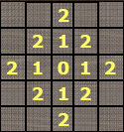
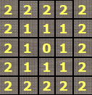
Distance Measures
The following are the different Distance measures:
a. Euclidean Distance :
D_{e}(p, q) = [(x-s)² + (y-t)²]^{1/2}
b. City Block Distance:
D₄(p, q) = |x-s| + |y-t|
c. Chess Board Distance:
D₈(p, q) = max(|x-s|, |y-t|)

Slide 69
Question 5
In the following arrangement of pixels, what’s the value of the chessboard distance between the circled two points?
0 0 0 0 0
0 0 1 1 0
0 1 1 0 0
0 1 0 0 0
0 0 0 0 0
0 0 0 0 0

Slide 70
Question 6
In the following arrangement of pixels, what’s the value of the city-block distance between the circled two points?
0 0 0 0 0
0 0 1 1 0
0 1 1 0 0
0 1 0 0 0
0 0 0 0 0
0 0 0 0 0

Slide 71
Question 7
In the following arrangement of pixels, what’s the value of the length of the m-path between the circled two points?
0 0 0 0 0
0 0 1 1 0
0 1 1 0 0
0 1 0 0 0
0 0 0 0 0
0 0 0 0 0

Slide 72
Question 8
In the following arrangement of pixels, what’s the value of the length of the m-path between the circled two points?
0 0 0 0 0
0 0 1 1 0
0 0 1 0 0
0 1 0 0 0
0 0 0 0 0
0 0 0 0 0

Slide 73
Introduction to Mathematical Operations in DIP
Array vs. Matrix Operation
Array product
operator
Array product
Matrix product
operator
Matrix product

Slide 74
Introduction to Mathematical Operations in DIP
Linear vs. Nonlinear Operation
H is said to be a linear operator;
H is said to be a nonlinear operator if it does not meet the above qualification.
Additivity
Homogeneity

Slide 75
Arithmetic Operations
Arithmetic operations between images are array operations. The four arithmetic operations are denoted as
s(x,y) = f(x,y) + g(x,y)
d(x,y) = f(x,y) – g(x,y)
p(x,y) = f(x,y) × g(x,y)
v(x,y) = f(x,y) ÷ g(x,y)

Slide 76
Example: Addition of Noisy Images for Noise Reduction
Noiseless image: f(x,y)
Noise: n(x,y) (at every pair of coordinates (x,y), the noise is uncorrelated and has zero average value)
Corrupted image: g(x,y)
g(x,y) = f(x,y) + n(x,y)
Reducing the noise by adding a set of noisy images, {g_{i}(x,y)}

Slide 77
Example: Addition of Noisy Images for Noise Reduction

Slide 78
Example: Addition of Noisy Images for Noise Reduction
In astronomy, imaging under very low light levels frequently causes sensor noise to render single images virtually useless for analysis.
In astronomical observations, similar sensors for noise reduction by observing the same scene over long periods of time. Image averaging is then used to reduce the noise.

Slide 79
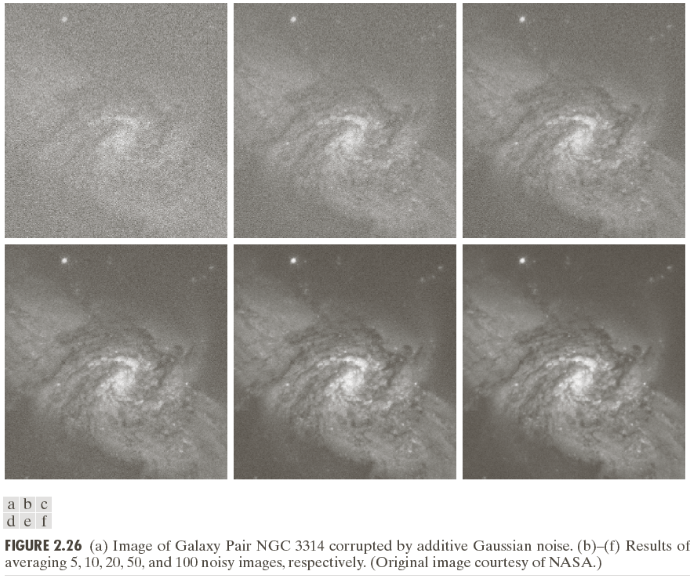

Slide 80
An Example of Image Subtraction: Mask Mode Radiography
Mask h(x,y): an X-ray image of a region of a patient’s body
Live images f(x,y): X-ray images captured at TV rates after injection of the contrast medium
Enhanced detail g(x,y)
g(x,y) = f(x,y) - h(x,y)
The procedure gives a movie showing how the contrast medium propagates through the various arteries in the area being observed.

Slide 81
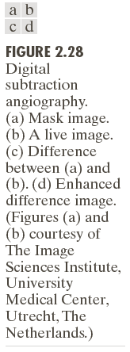

Slide 82
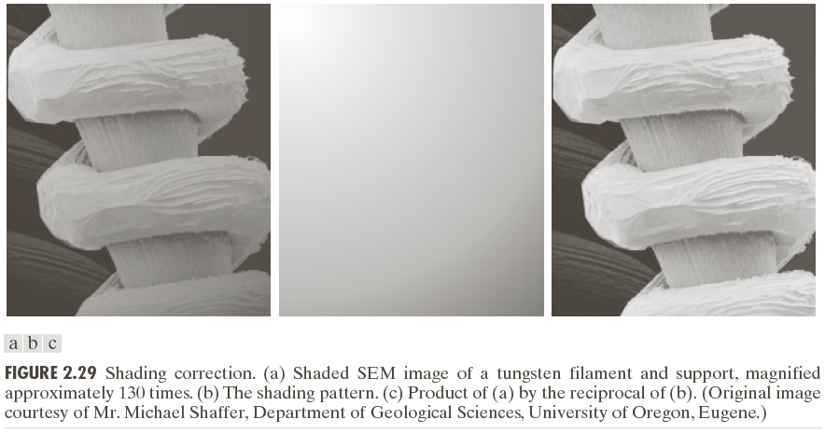
An Example of Image Multiplication

Slide 83
Set and Logical Operations

Slide 84
Set and Logical Operations
Let A be the elements of a gray-scale image
The elements of A are triplets of the form (x, y, z), where x and y are spatial coordinates and z denotes the intensity at the point (x, y).
The complement of A is denoted A^{c}

Slide 85
Set and Logical Operations
The union of two gray-scale images (sets) A and B is defined as the set

Slide 86
Set and Logical Operations

